Slide 1
Strategic Financial Analysis for Nestlé (2022–2024)
Prepared for Managerial Decision-Making

Slide 2
ABOUT US
Over the past three years, Nestlé has shown consistent top-line growth, with revenue increasing from CHF 90,000 million in 2022 to CHF 98,500 million in 2024. However, to remain competitive in a rapidly evolving consumer landscape and drive bottom-line improvements, we must move beyond surface growth and focus on strategic cost control, margin optimization, and targeted expansion. Below are key insights and data-driven recommendations:

Slide 3
Income statement snapshot
Particulars | 2022 | 2023 | 2024
Revenue (Sales) | 90,000 | 94,000 | 98,500
Cost of Goods Sold (COGS) | -56,000 | -57,800 | -59,100
Gross Profit | 34,000 | 36,200 | 39,400
Selling, General & Admin (SG&A) | -23,800 | -24,800 | -26,000
R&D Expenses | -1,400 | -1,500 | -1,600
Depreciation & Amortization | -2,600 | -2,800 | -3,000
Operating Profit (EBIT) | 6,200 | 7,100 | 8,800
Gain on Sale of Assets | 110 | 130 | 150
Foreign Exchange Gain / (Loss) | -180 | -190 | -200
Other Non-Operating Income | 90 | 100 | 100
Earnings Before Interest & Taxes | 6,220 | 7,140 | 8,850
Interest Expense | -850 | -900 | -950
Interest Income | 260 | 290 | 320
Earnings Before Tax (EBT) | 5,630 | 6,530 | 8,220
Income Tax Expense (20%) | -1,126 | -1,306 | -1,644
Net Income | 4,504 | 5,224 | 6,576

Slide 4
PROBLEM
revenue
Increasing at a low rate
Net income
5% of Revenue
COSTS
Increasing every year, causing the final Net Income to decrease

Slide 5
Next Steps
REVENUE GROWTH STRATEGY
SG&A CONTROL
MARGIN EXPANSION
COGS OPTIMIZATION

Slide 6
Revenue Growth Strategy: Shift from Volume to Value
While revenue grew at a CAGR of ~4.6%, this pace is moderate for a global FMCG brand. Instead of chasing pure volume, Nestlé can increase revenue through premiumization—offering value-added, health-focused, or sustainable variants of existing product lines. These often carry higher price points and better margins. Additionally:
Expand digital and direct-to-consumer (D2C) channels to tap younger demographics
Enter high-growth regions (e.g., Southeast Asia, Sub-Saharan Africa) where Nestlé has under-penetrated segments
Reinforce cross-brand bundles and loyalty programs to increase average order value per customer

Slide 7
REVENUE TREND

Slide 8
COGS Optimization: Supplier Consolidation & Smart Procurement
Although Gross Profit Margin improved from 37.8% to 40% by 2024, COGS still accounts for over CHF 59,000 million—60% of total revenue. This leaves significant room to optimize:
Consolidate suppliers to negotiate better rates on raw materials
Leverage AI in demand forecasting to reduce overproduction and
inventory holding costs
Partner with local suppliers in emerging markets to cut
logistics expenses

Slide 9
COGS & GROSS PROFIT MARGIN

Slide 10
SG&A Control: Audit Spending Mix, Not Just the Total
SG&A has steadily increased but held flat as a % of
revenue (~26–27%). However, not all SG&A categories
are equally efficient. An internal audit should identify:
Which marketing channels drive ROI and reallocate
spend accordingly (e.g., cut underperforming
offline campaigns)
Whether admin overheads and support roles
have scaled proportionally with revenue or are
bloating
If R&D (~CHF 1,600M in 2024) is translating into
actual product launches or patents
Also, outsourcing non-core functions like payroll
or IT support can offer cost savings without
affecting product quality.

Slide 11
SG&A ALLOCATION

Slide 12
Margin Expansion: Focus on Operational Efficiency
EBITDA margin grew from 9.8% in 2022 to 12%
in 2024—a solid improvement. To continue this
trajectory:
Introduce lean manufacturing principles in
underperforming factories
Automate repetitive tasks in finance, HR,
and supply chain
Implement dynamic pricing strategies to respond
to raw material price fluctuations in real time

Slide 13
EBITDA MARGIN

Slide 14
Improve Interest Coverage & Cash Flow
The interest coverage ratio rose to 9.26× in 2024, showing improved profitability and
debt servicing ability. However, interest expense is still a significant cost (CHF 950M).
We recommend:
Using surplus cash to reduce high-interest debt
Reassessing short-term borrowings and renegotiating terms, especially in low-interest regions
Exploring green financing options or sustainability-linked loans which carry incentives for
ESG compliance

Slide 15
INTEREST COVERAGE RATIO

Slide 16
CONCLUSION
Nestlé is financially stable and operationally
improving, but we must now shift focus from
growth to targeted efficiency. Every 1%
improvement in gross margin or SG&A efficiency can
unlock hundreds of millions in net profit. Next, we recommend:
Running a segment-wise profitability analysis
Launching a cost transformation task force
Piloting new margin-boosting initiatives in 1–2 test
markets before global rollo

Slide 17
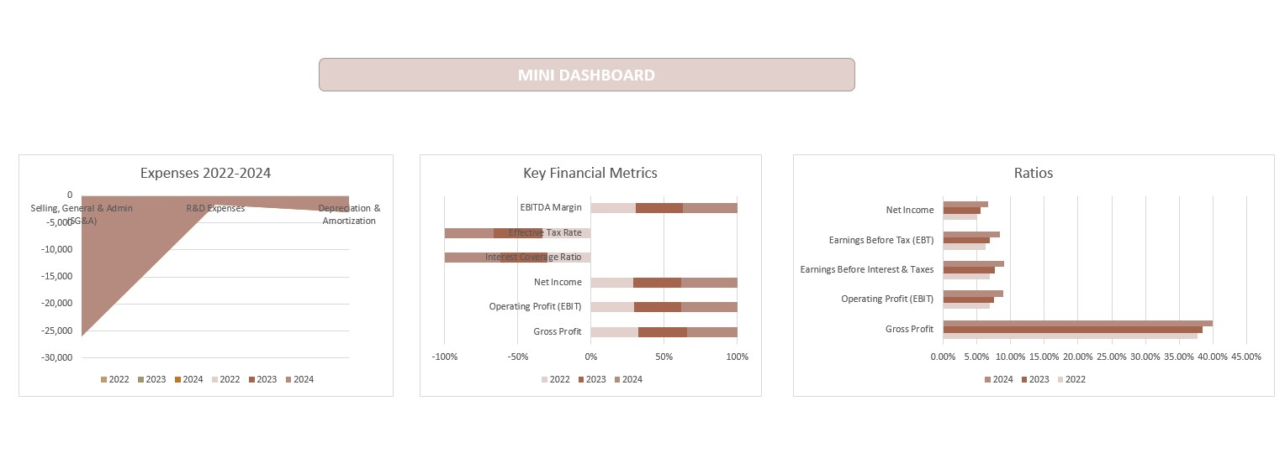
Excel dashboard

Slide 18
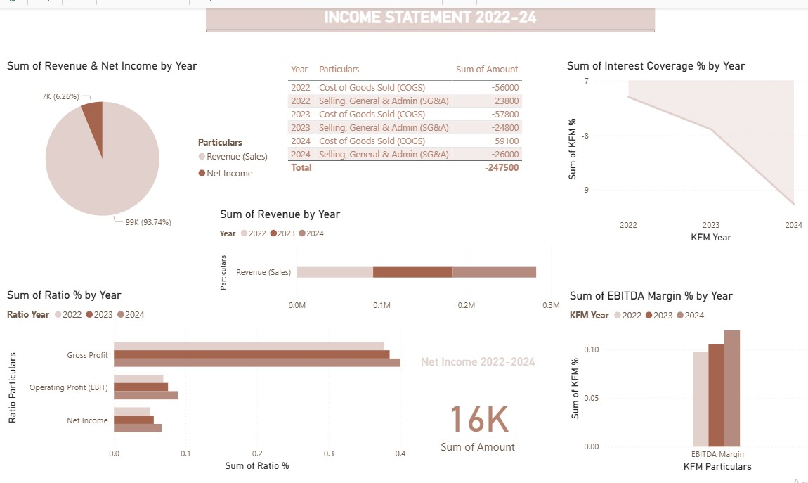
Power bi dashboard

Slide 19
THANK YOU
Sania Muqthar

